Slide 1
Men of God in Groups
Support and Accountability

Slide 2
Prayer Groups
Accountability partners
Intercessory prayer

Slide 3
Ecclesiastes 4:9-12
“Two are better than one, because they have a good return for their labor: If either of them falls down, one can help the other up. But pity anyone who falls and has no one to help them up. Also, if two lie down together, they will keep warm. But how can one keep warm alone? Though one may be overpowered, two can defend themselves. A cord of three strands is not quickly broken.”

Slide 4
Empowered for good
James 5:16 “Therefore confess your sins to each other and pray for each other so that you may be healed. The prayer of a righteous man is powerful and effective.”

Slide 5
Action and Faith
Mark 2:3 “Then they came to him carrying a paralytic who was carried by four men.”
Mark 2:5 “When Jesus saw their faith He said to the paralytic, “Son your sins are forgiven you.”

Slide 6
2 Samuel 23:16-18
“Then Jonathan, Saul’s son, arose and went to David in the woods and strengthened his hand in God. And he said to him, “Do not fear, for the hand of Saul my father shall not find you. You shall be king over Israel, and I shall be next to you. Even my father Saul knows that.” So the two of them made a covenant before the Lord. And David stayed in the woods, and Jonathan went to his own house.”

Slide 7
Philippians 2:4
“In humility value others above yourselves, not looking to your own interests but each of you to the interests of others.”

Slide 8
Proverbs 11:25
“A generous person will prosper; whover refreshes others will be refreshed.”

Slide 9


Slide 10


Slide 11


Slide 12
Things to watch for
People who take over.
Confidentiality
Variety
Train leaders
Mentor the next generation.
Projects that serve

Slide 13

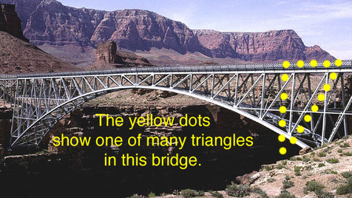

Slide 14
The leader has to go first.

Slide 15
“And what more shall I say? I do not have time to tell about Gideon, Barak, Samson and Jephthah, about David and Samuel and the prophets, who through faith conquered kingdoms, administered justice, and gained what was promised; who shut the mouths of lions, quenched the fury of the flames, and escaped the edge of the sword; whose weakness was turned to strength; and who became powerful in battle…” Hebrews 11:32-34

